Slide 1
Data Interpretation

Slide 2
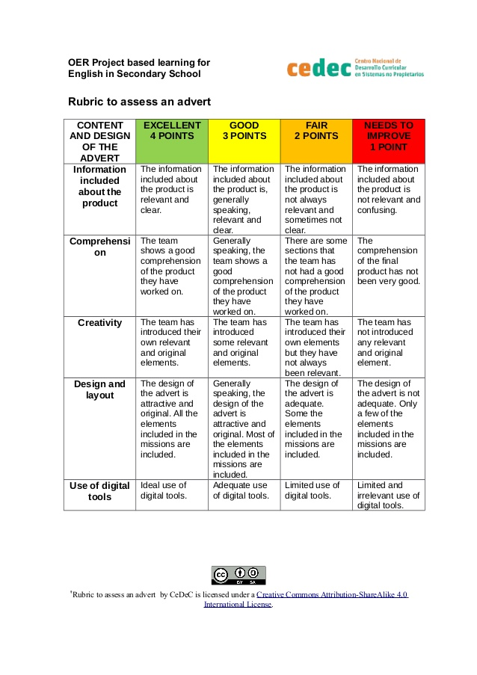

Slide 3
Task
Group Number | Information included about the product/Idea | Comprehension | Creativity | Design & Layout | Use of digital tools
Team 1
Team 2
Team 3
Team 4
Team 5
Team 6
Team 7

Slide 4
Analytical Paragraph Notes
Features of an Analytical Paragraph:
• It describes the given chart, table, data, graph, cues etc.
• It should be brief and comprehensive but at the same time, include complete
information.
• It should state the facts that are provided.
• It should have simple and accurate language.
• It should mention figures and quantities appropriately.
• It should use the same tense throughout, as far as possible.
• It should not provide any personal observation or response.
• It should preferably use the passive form of the verb.

Slide 5
Format of an Analytical Paragraph
Content in 100-120 Word:
The content of the paragraph must include the following:
• Introduction (explain in one or two lines the context or what is clearly evident from the
chart or graph)
• Body of the paragraph (explain in detail the figure and trends, making comparisons and
contrasts)
• Conclusion (give the overall view or summary of the chart or graph)

Slide 6
Points to Remember
We must not include any personal opinions, conclusions or observations but simply stick to the facts.
• We must choose wisely the important information, organize it well, state the correct facts and summarize it properly.
• For introduction, we can start with phrases such as The chart given above describes…/The given table suggests…/ The line graph shows…/ The data given provides information about…/ The pie chart illustrates…, etc.
• For body of the paragraph, we should organize the information well. We should look for the large differences that are very prominent. We can mention the aspect which is the smallest or the largest in the data given. Any aspect that is similar should be mentioned next. We should further mention about the aspect that has remained unchanged or is constant throughout.

Slide 7
Points to Remember
If the chart or table mentions two different groups, we should refer to both of them in the paragraph. If there is any contrast or comparison that could be drawn, we must present it effectively. If the chart is about a particular time period or highlights trends of several years, we should mention about each year in a concise manner. If any comparison or contrast can be made for two or more years, we should write about that too.
• For describing the pattern of growth, we can use words and phrases like- ‘rapidly doubled’, ‘skyrocketed’, ‘striking increase’, ‘peaked’, ‘soared’, ‘declined’, ‘plummeted’, ‘leveled off’, ‘stagnated’, ‘fluctuating’ , ‘starting to rise’, ‘starting to fall’, ‘drop down’, ‘slightly’, etc.
• Mentioning quantities: When including numbers and figures, the accuracy must be ensured. Quantities can be described in a number of ways, such as percentage, fraction, ratios etc. For describing quantities, we can also use words and phrases like ‘one-third of’, ‘nearly one-fourth of’, ‘majority’, ‘on an average’, ‘twice as much’, ‘almost equal’, ‘the highest’, ‘the lowest’, ‘approximately’, etc.
• For establishing relationship or contrast, we can make use of words and phrases like- ‘similarly’, ‘in contrast with’, ‘ in comparison to’, ‘however’, ‘whereas’, ‘as opposed to’, ‘while’, ‘a striking difference’, ‘a noticeable difference’, etc.
• For conclusion, we may use words and phrases like ‘overall’, ‘subsequently’, ‘in all’, ‘in a nutshell’, ‘in short’, ‘therefore’, etc.

Slide 8
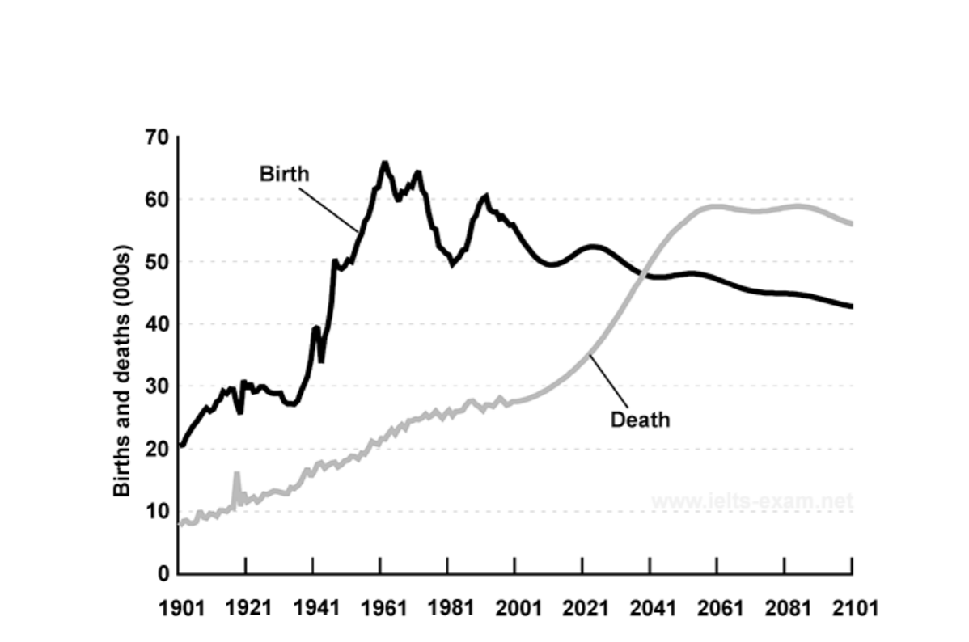
Q1. The given line graph provides information about changes in birth and death rates in New Zealand between 1901 and 2101. Write an analytical paragraph summarizing the information and make comparisons where relevant in about 100-120 words.

Slide 9
Answer
The graph shows changes in the birth and death rates in New Zealand since 1901 and forecasts trends till 2101.Between 1901 and 2041, the birth rate has been consistently higher than the death rate. It stood at 20000 in 1901, at the start of this period and started increasing gradually after that. It reached to its peak of around 65000 in 1961. Since then, the birth rate has fluctuated between 50000 and 60000. It is expected to decline in the coming years, reaching approximately 42000 by 2101.In contrast, the death rate stood at around 10000 in 1901 and has increased steadily after that. It is expected to rise strikingly from 2021 before leveling off to approximately 60000 between 2061 and 2081. The graph indicates a slight decline in deaths in the year 2101.The graph shows a huge gap between birth rate and death rate from 1961 to 2001. However, this gap is expected to reduce in the later years. Overall, as opposed to the prevailing trends, the death rate will be reversed and will be more than the birth rate in the later part of this century

Slide 10
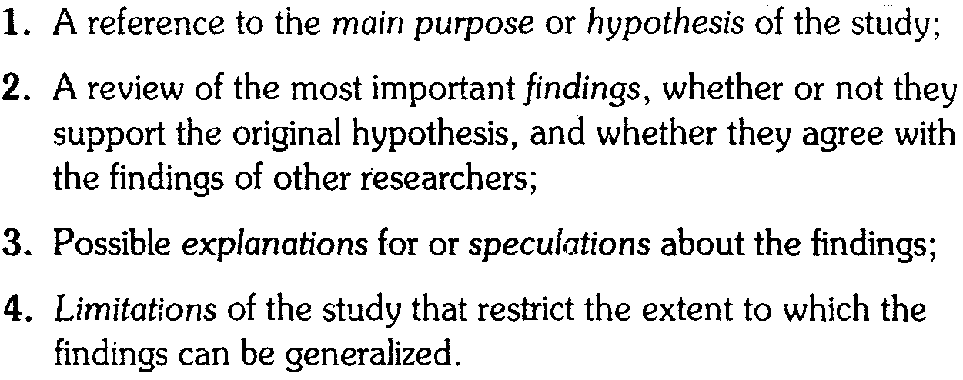
First Information Elements in Discussion Specific Reference to the Study

Slide 11
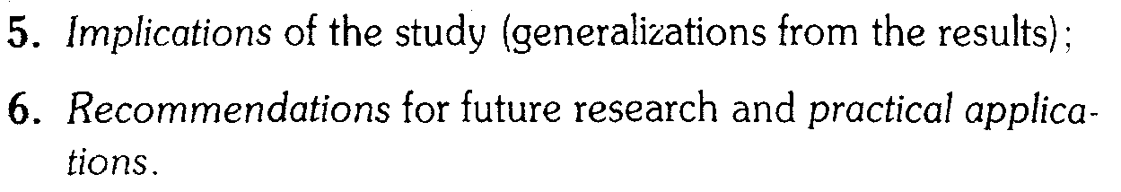
Later Information Elements in Discussion General Statements about the Study

Slide 12
Researcher’s Position towards the Findings
Researcher’s views become explicit on the study and its findings
May take a position with respect to the explanation, implications, limitations, or applications of the findings (Elements 3, 4, 5, and 6)

Slide 13
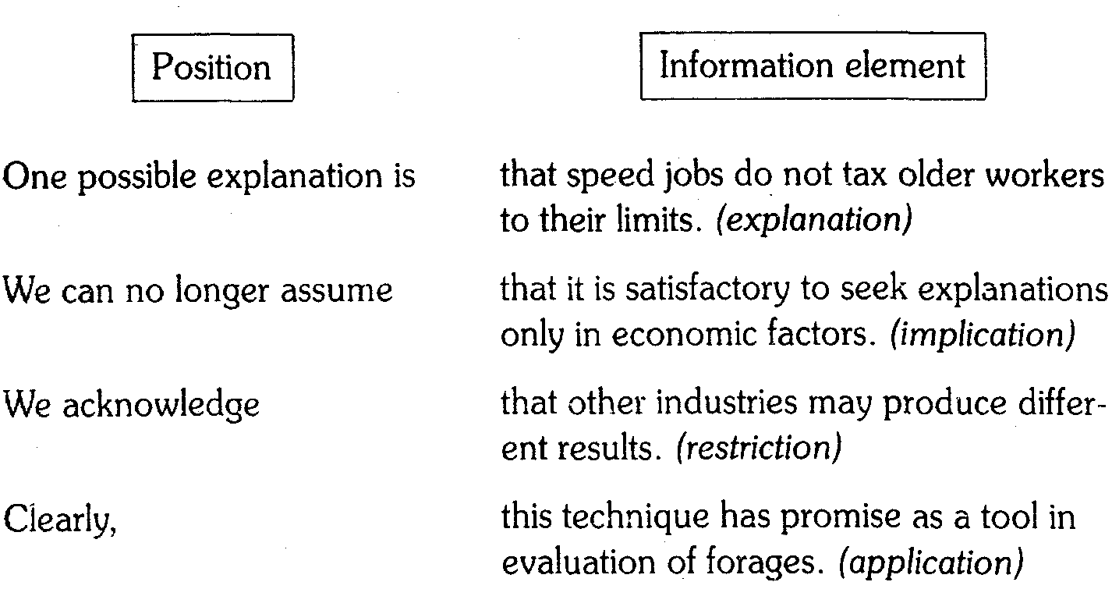
Researcher’s Position on Information in the Discussion

Slide 14
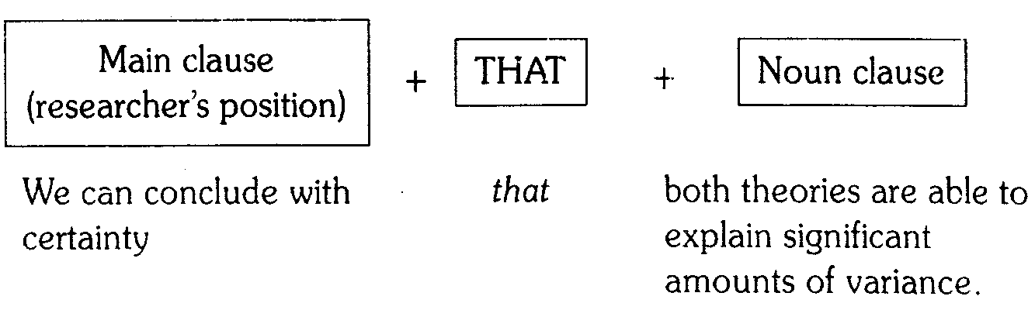
Language Focus Complex structure in Discussion Statements
Main clause and Noun clause
Main clause carries the researcher’s position
Information being reported is contained in the noun clause

Slide 15
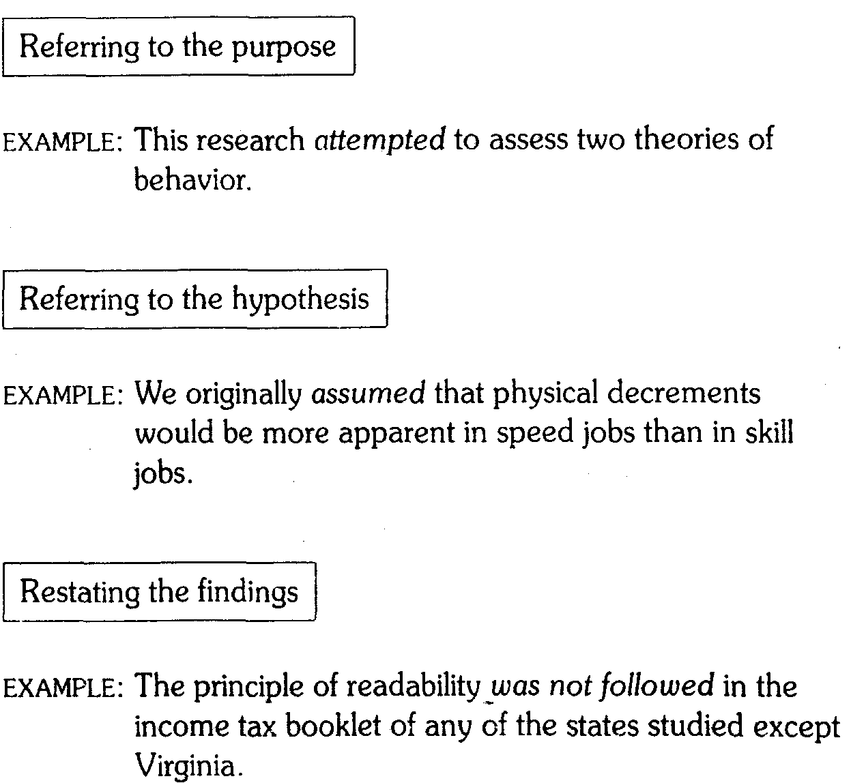
Verb Tenses in First Discussion Elements Simple Past Tense (1)

Slide 16
Verb Tenses in First Discussion Elements Past, Present and Modal auxiliaries (2)
The past, present, or modal auxiliaries may be used in discussion statements that explain possible reasons for, or limitations to, the findings.
The choice depends on whether the explanation for the specific findings is restricted to your study (past) or whether it refers to a general condition (present).
Modal auxiliaries may also be used to emphasize the speculative nature of these statements.

Slide 17
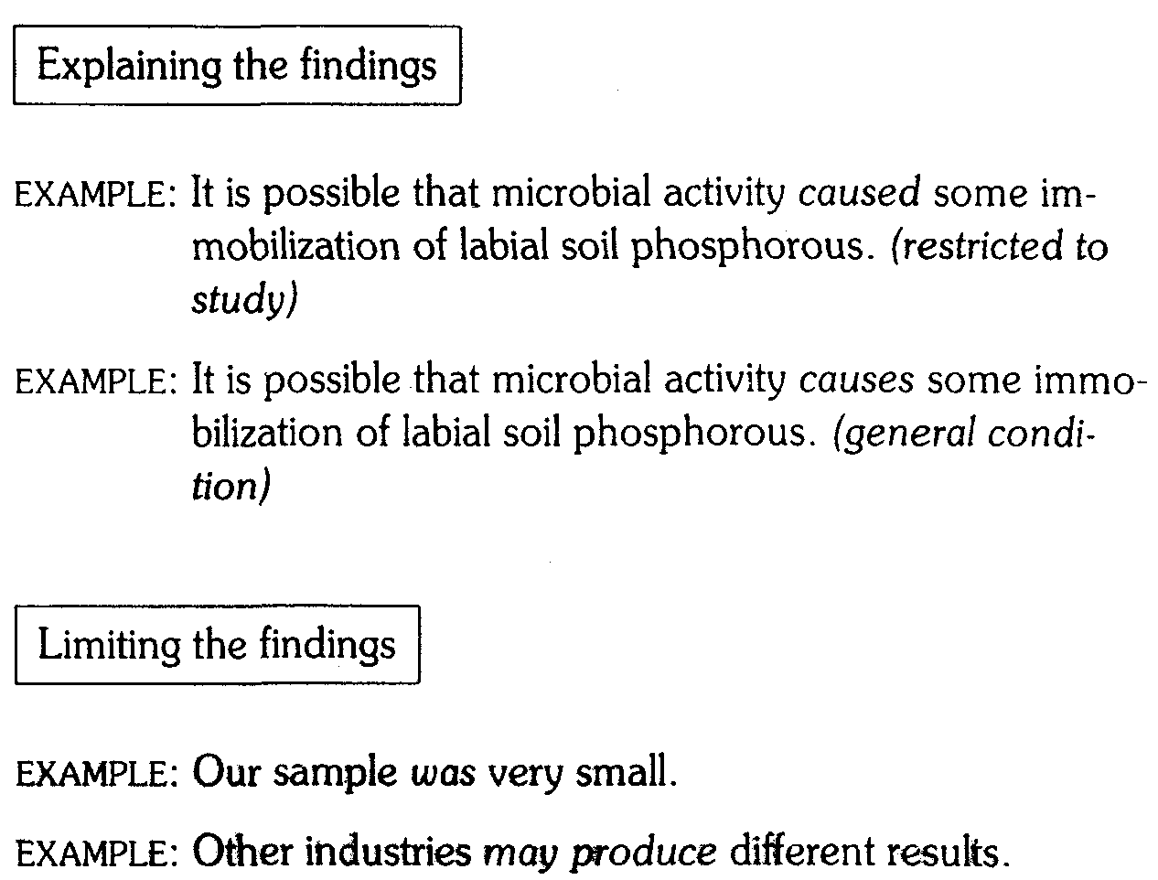
Verb Tenses in First Discussion Elements Past, Present and Modal auxiliaries (2)

Slide 18
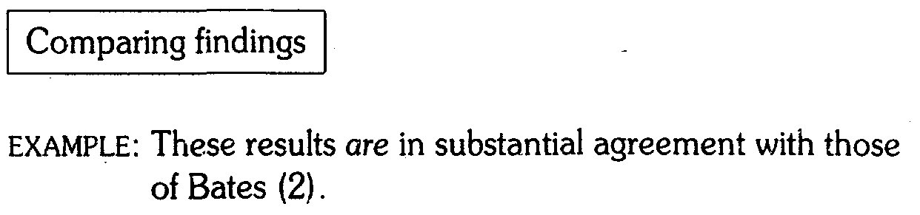
Verb Tenses in First Discussion Elements Past, Present and Modal auxiliaries (3)

Slide 19
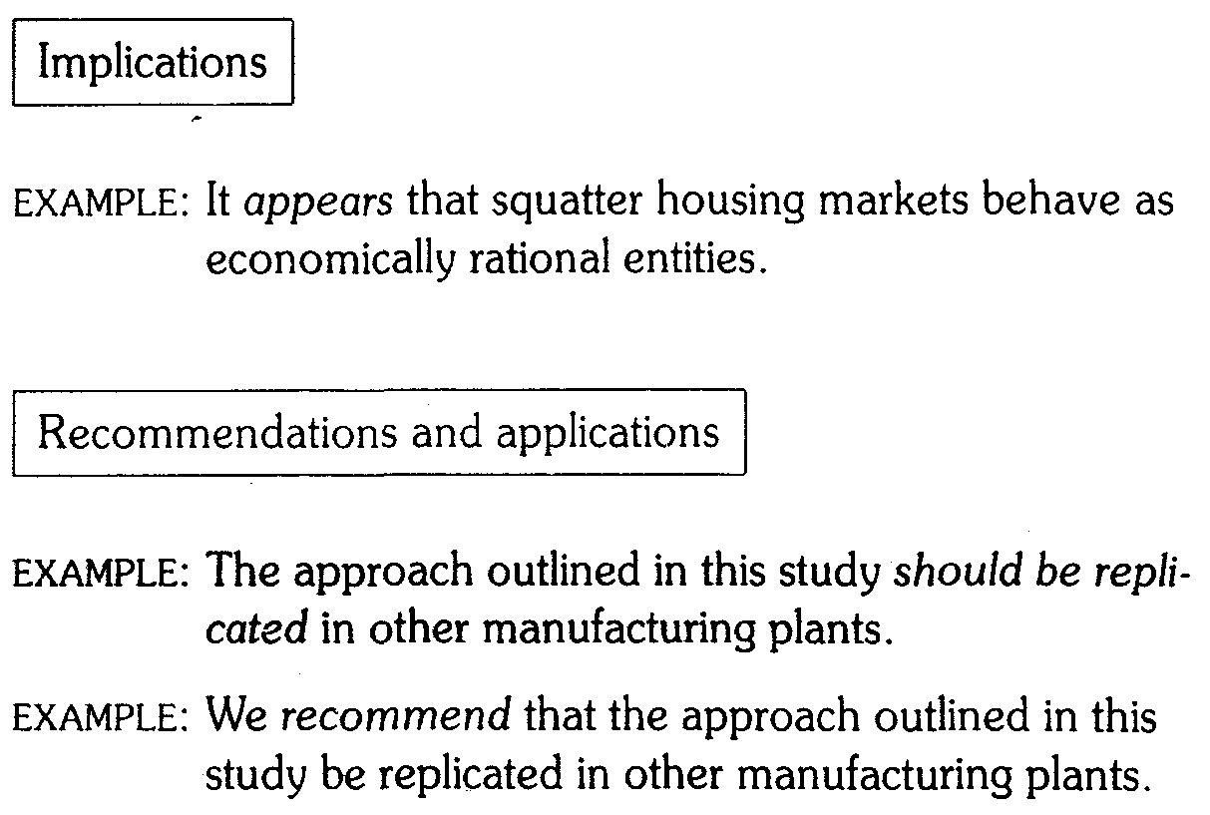
Verb Tenses in Later Elements Present and Modal Auxiliaries/Tentative Verbs

Slide 20
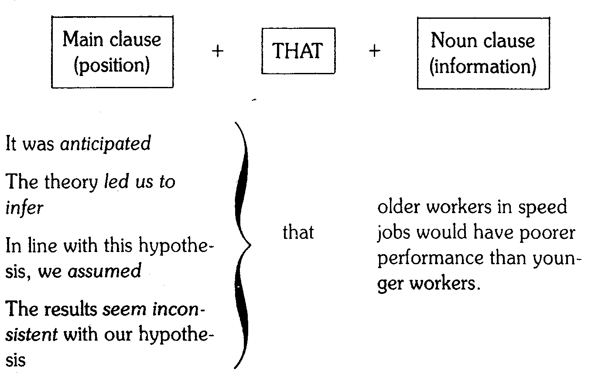
Expressions for Restating the Hypothesis

Slide 21
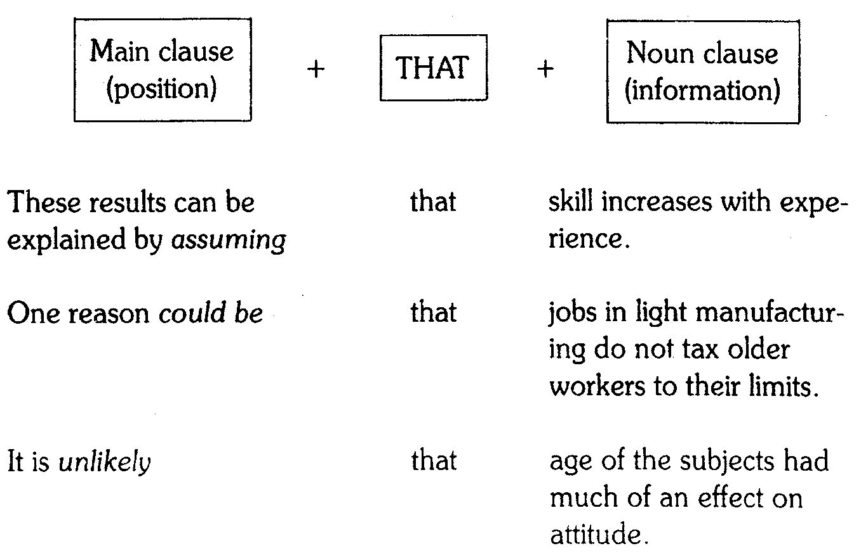
Expressions for Explaining Findings

Slide 22
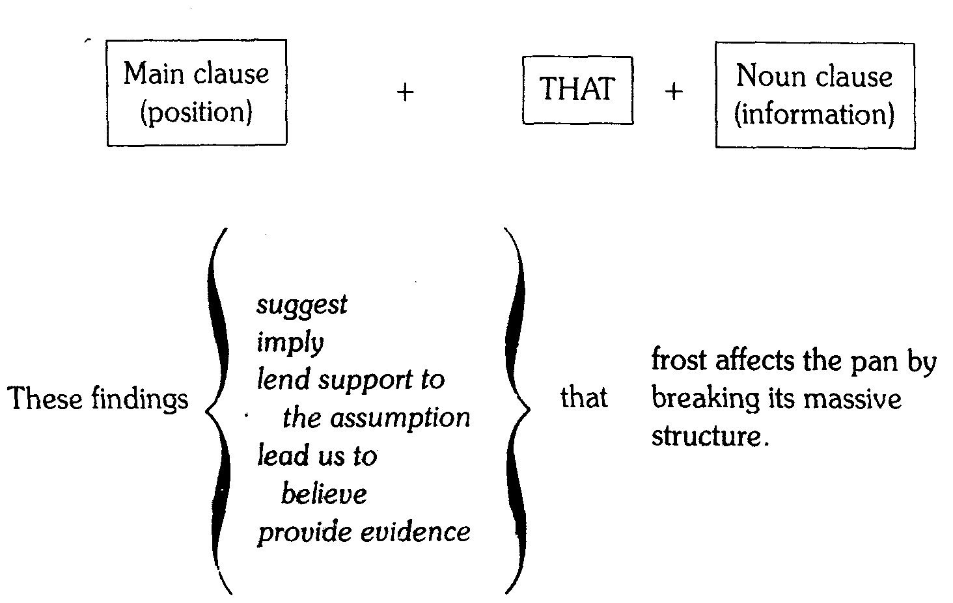
Expressions for Suggesting Implications

Slide 23
Quick Check
Include various elements of information, depending on the problems encountered, results obtained, possible applications, and further researcher needed.
Move from specific results to general implications.
Use complex structures including noun clauses to express your position towards the findings.
Use past tense to refer to the original hypothesis and to review your results.
Use the simple present, simple past, or modal auxiliaries when explaining and limiting your results.
Use the simple present tense to compare your findings with those of others.
Use the simple present and modal auxiliaries or tentative verbs to make implications or recommendations or to suggest applications.
Use special expressions to indicate your position towards any of the information elements included.

Slide 24
Your turn!

